Slide 1
Pop Quiz
How many tenders a year do we buy?

Slide 2
Pop Quiz
How many tenders a year do we buy?
1.2 million – if we put them in a line would stretch for 12km

Slide 3
Pop Quiz
How many kgs a year do we buy of buttermilk and herb

Slide 4
How many kgs a year do we buy of buttermilk and herb
15 tonnes

Slide 5
How many tonnes of Crinkle Cut fries do we buy a year?

Slide 6
How many tonnes of Crinkle Cut fries do we buy a year?
173 tonnes equivalent to 44 elephants…

Slide 7
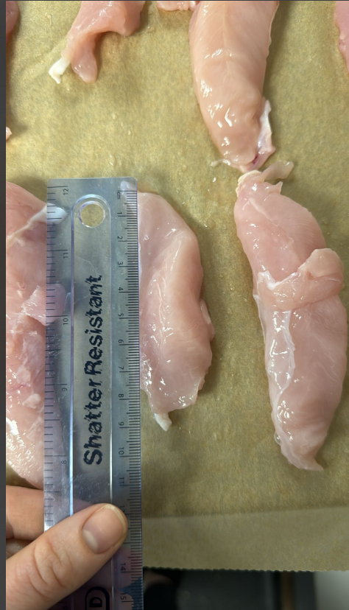
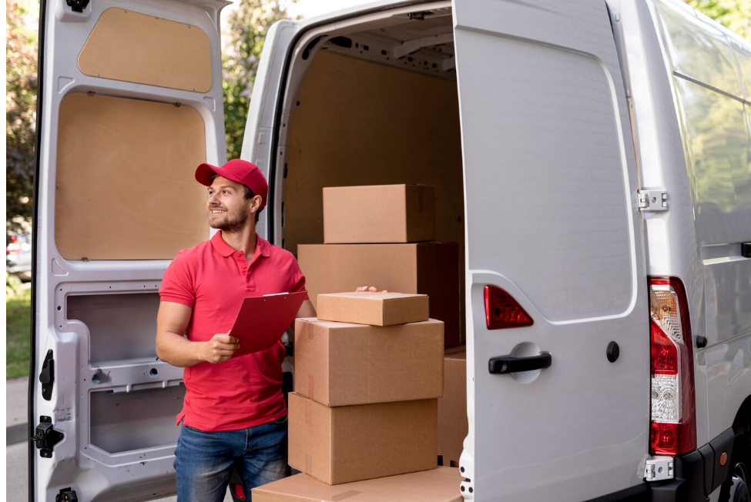
Challenges

Slide 8
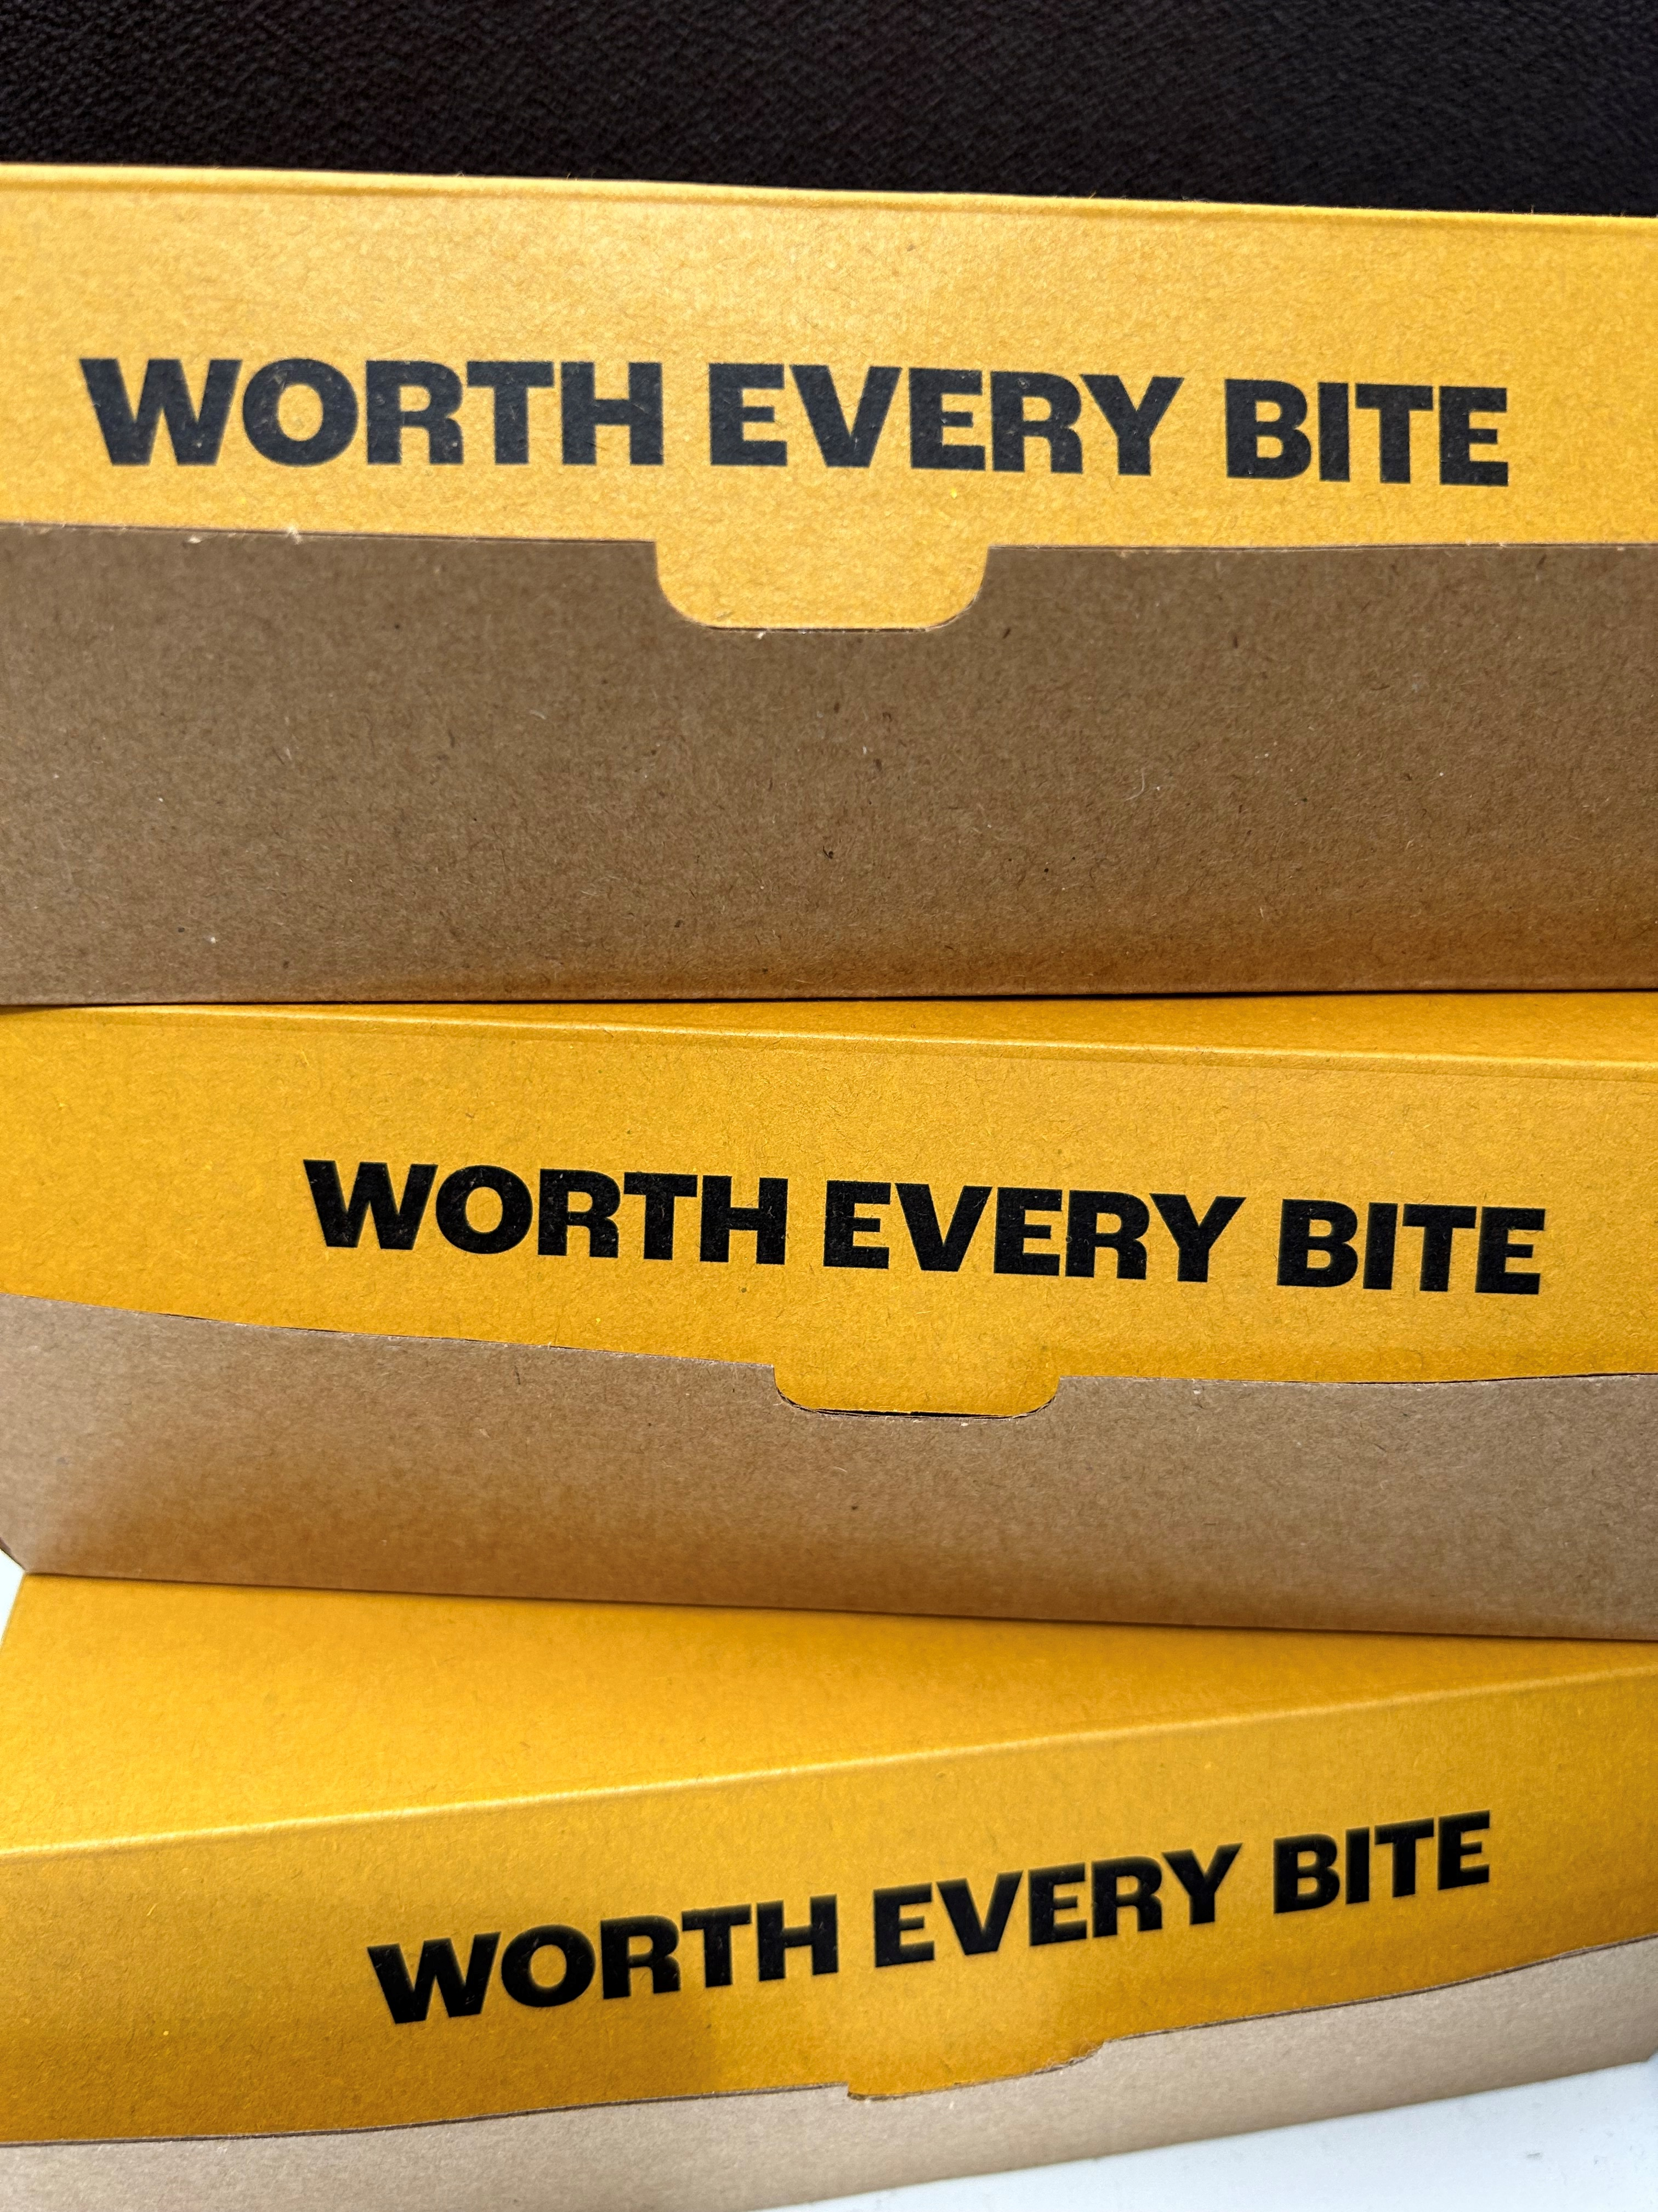
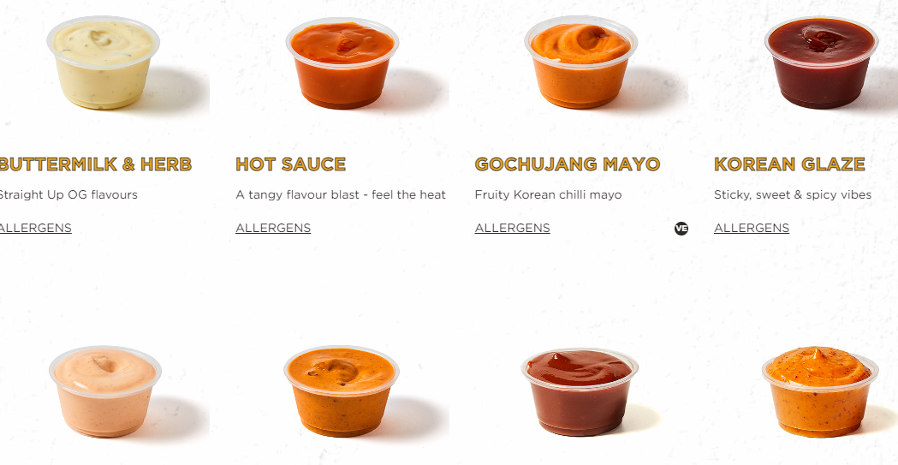
Wins

Slide 9
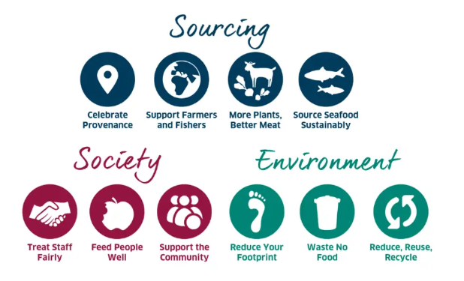
What Else?
Sustainability

